Slide 1
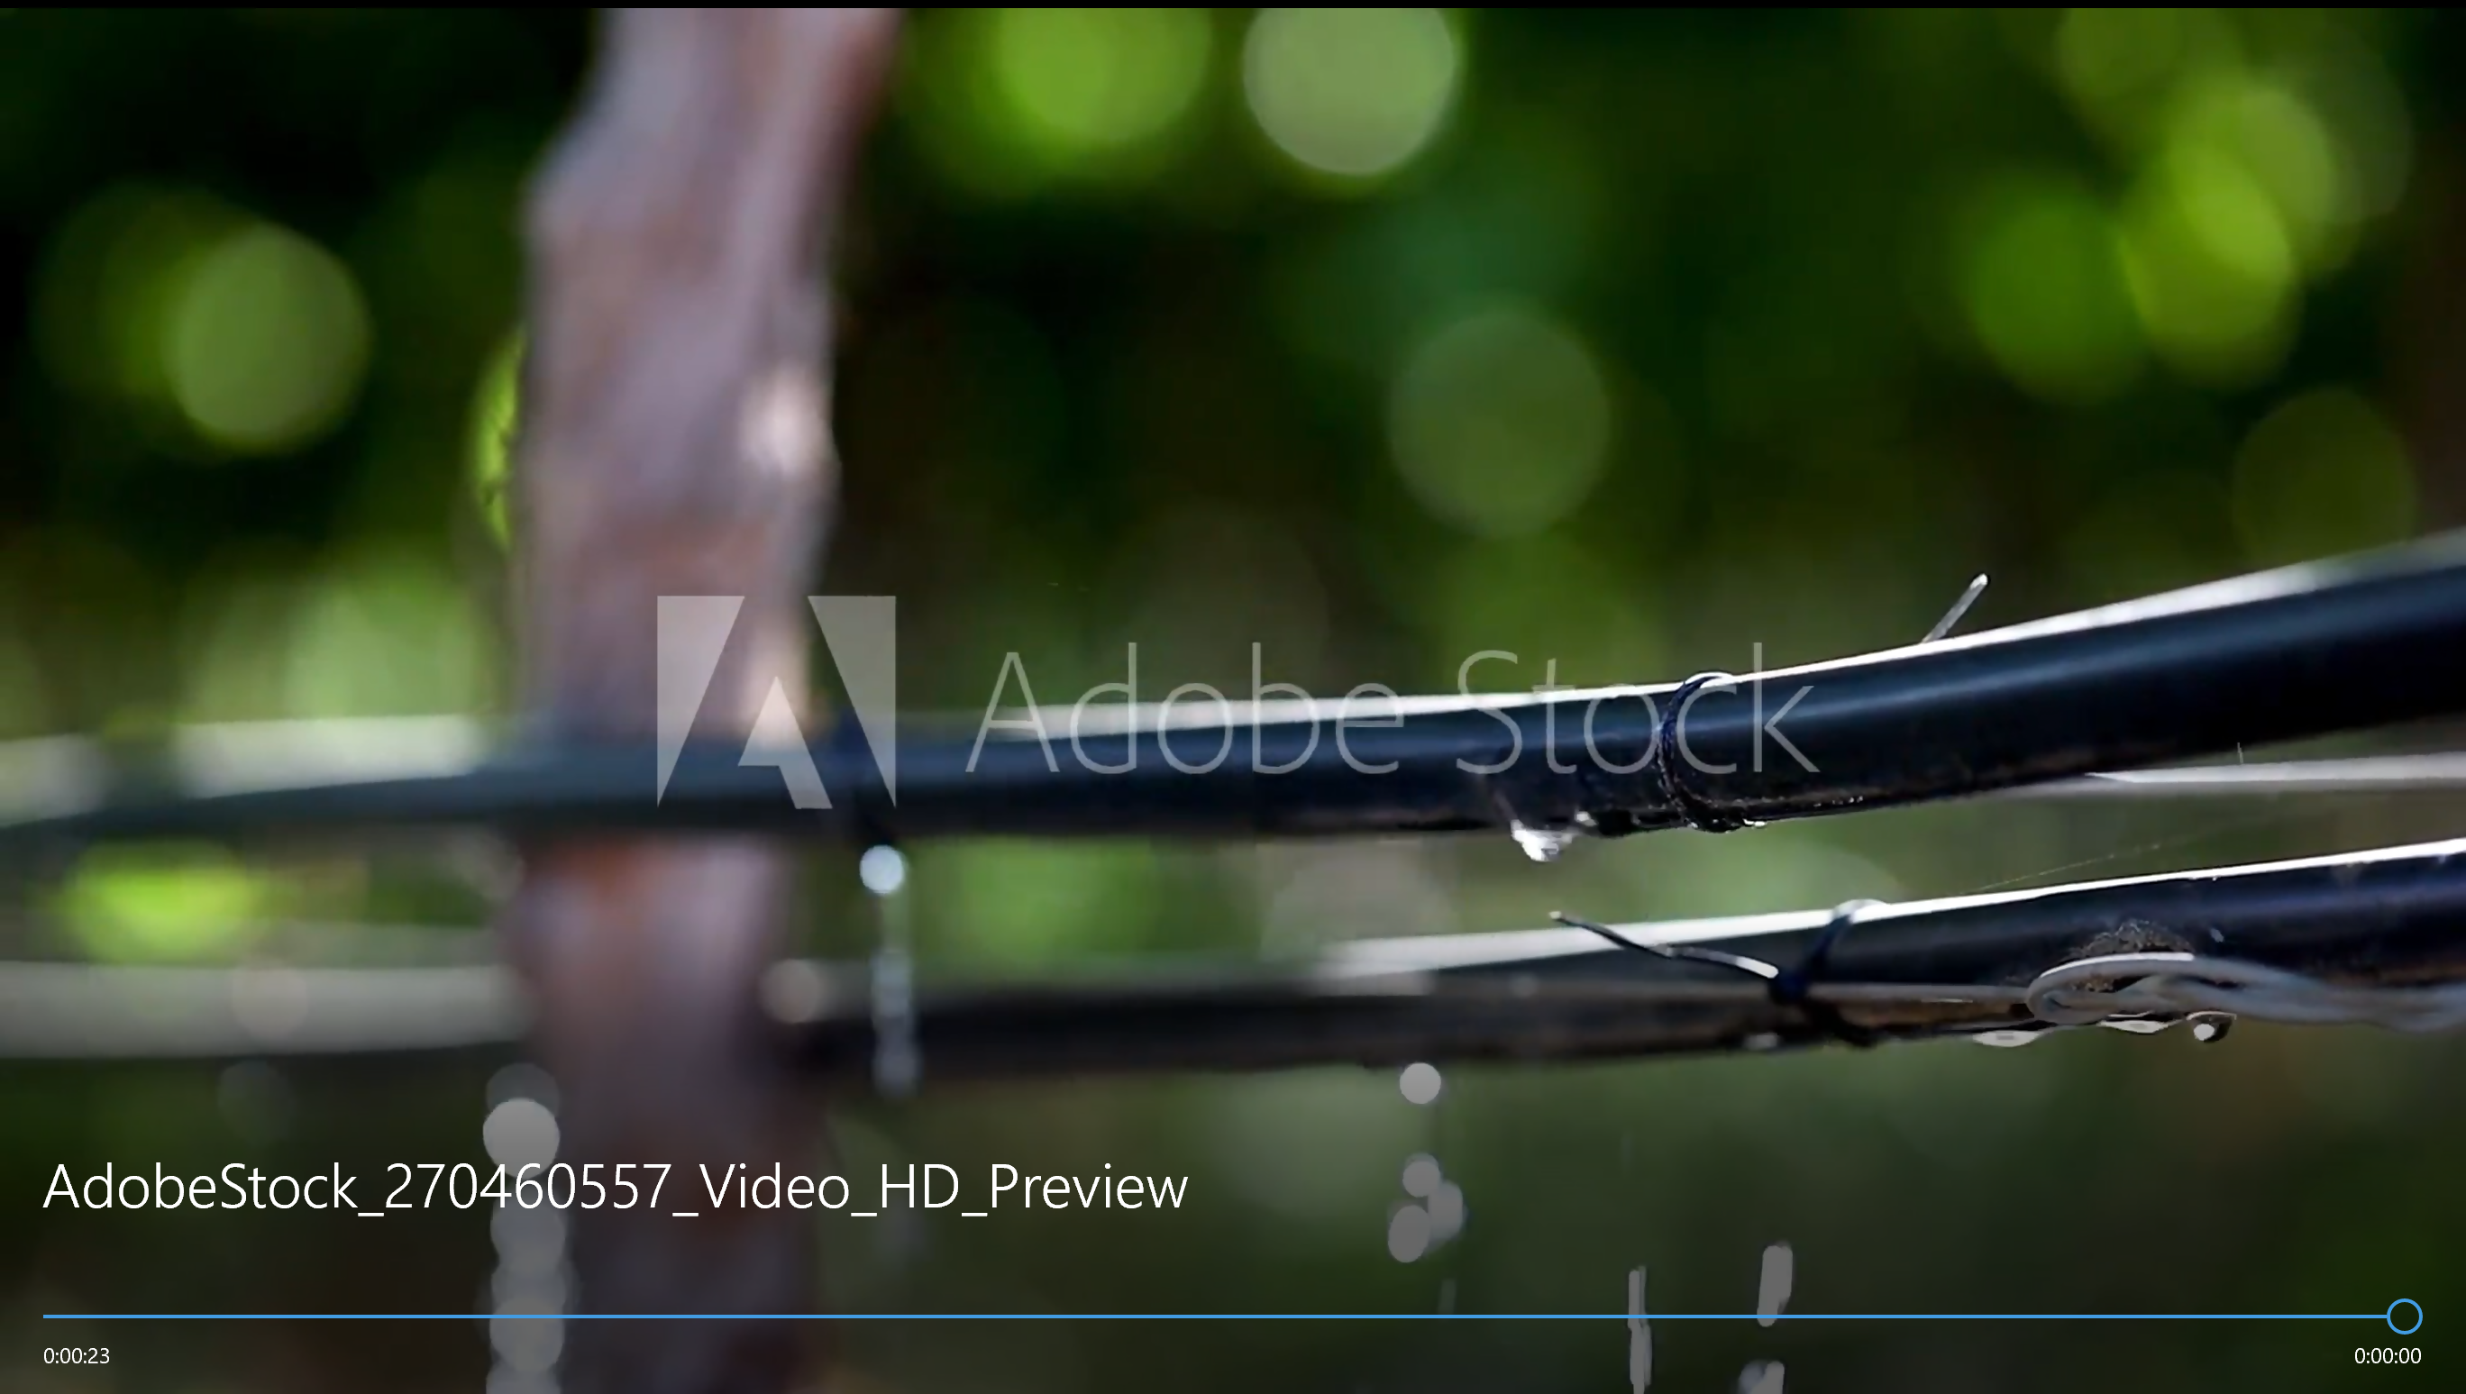
Water Management
As a Service
What Is It?
How It Works
Watever, Inc
Why We Care
Have peace of mind knowing that we will manage your irrigation and reduce your water bill by 25% or more
Who To Contact
Scroll Down

Slide 2
What Is It?
Scroll up
Have peace of mind knowing that we will manage your irrigation without compromising vineyard or orchard health or crop yield while we reduce your water bill by 25% or more.
We install an award-winning, low-cost soil moisture monitoring system in your vineyard or orchard that delivers precision irrigation.
By improving irrigation accuracy, 25% saving of water use was achieved over two growing seasons in a 10 acre vineyard.
What Is It?
How It Works
Using computer systems, we determine when to start and stop irrigating, and for how long to keep optimal soil moisture level to produce better fruit quality and yield.
Most commercially available systems are only economically feasible for large farms, leaving smaller growers without options to improve their water use.
Why We Care
Who To Contact
We improve irrigation accuracy with wireless automation, and remotely check the amount of water applied.
The solution is designed specifically to meet the requirements of vineyard and orchard operations between 1 and 10 acres.
We charge a flat fee of $39/month to manage your water
Scroll Down
CONTACT US

Slide 3
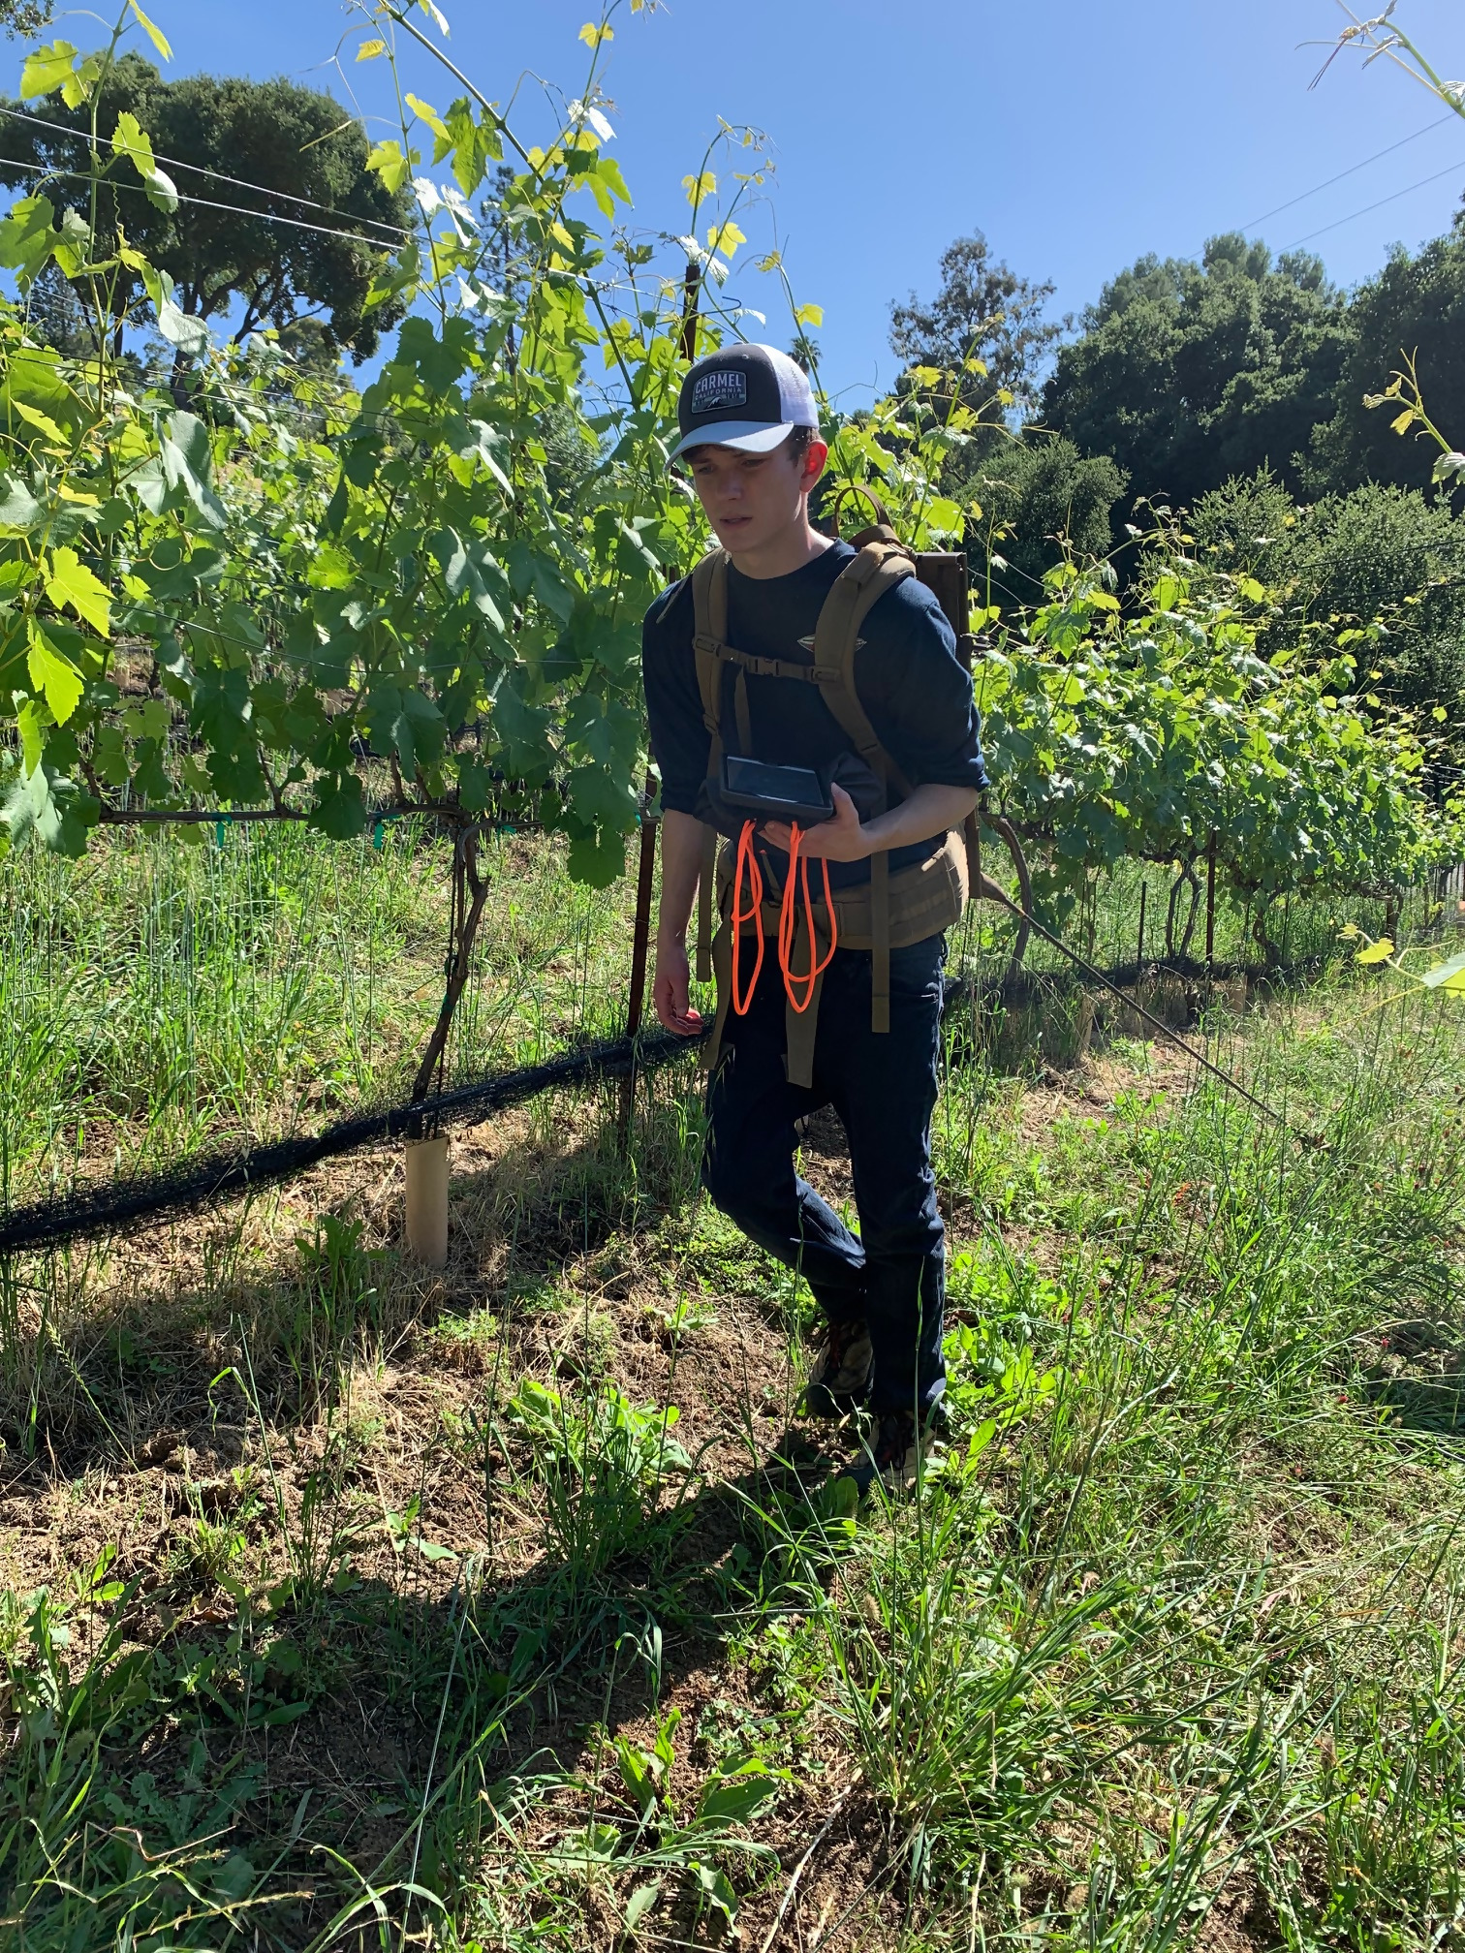
How It Works
Scroll up
We start by doing a geophysical survey to characterize the near surface soils down to 9 feet. That enables us to understand uniformed soil areas and where to position the soil sensors to define a correct plan for precision irrigation. We use electromagnetic terrain conductivity and ground penetrating radar surveys to map the vineyard or orchard.
Once we have mapped the vineyard or orchard, we install our Internet-based soil sensors in the active root zone and measure everything from soil texture to soil moisture and temperature.
An Arduino Pro single-board computer transmits data from the soil sensors to the Internet over a Low Range Wide Area Network (LoRaWAN) gateway. Using LoRa, a license-free, long-range wireless technology, we can connect up to 300 sensor stations at a time across a 6 miles radius. All components are FCC approved.
Each sensor station is designed for continuous unattended operation, and is powered by a small solar panel. The battery charger keeps the battery fully charged to keep the system working during the night and during periods with dense cloud cover. It has a built-in power switch that delivers power to active sensors, saving power by activating the sensors only when a measurement is taken.
What Is It?
How It Works
Why We Care
Who To Contact
Scroll Down

Slide 4
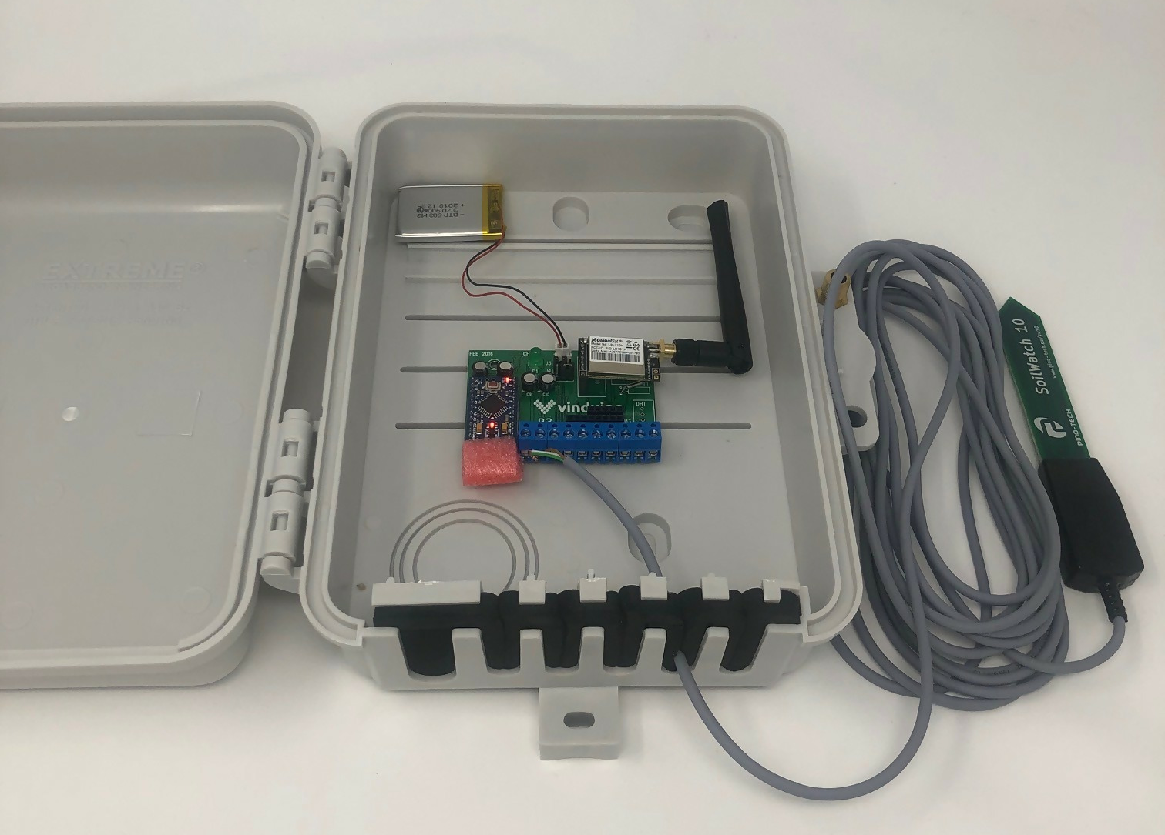
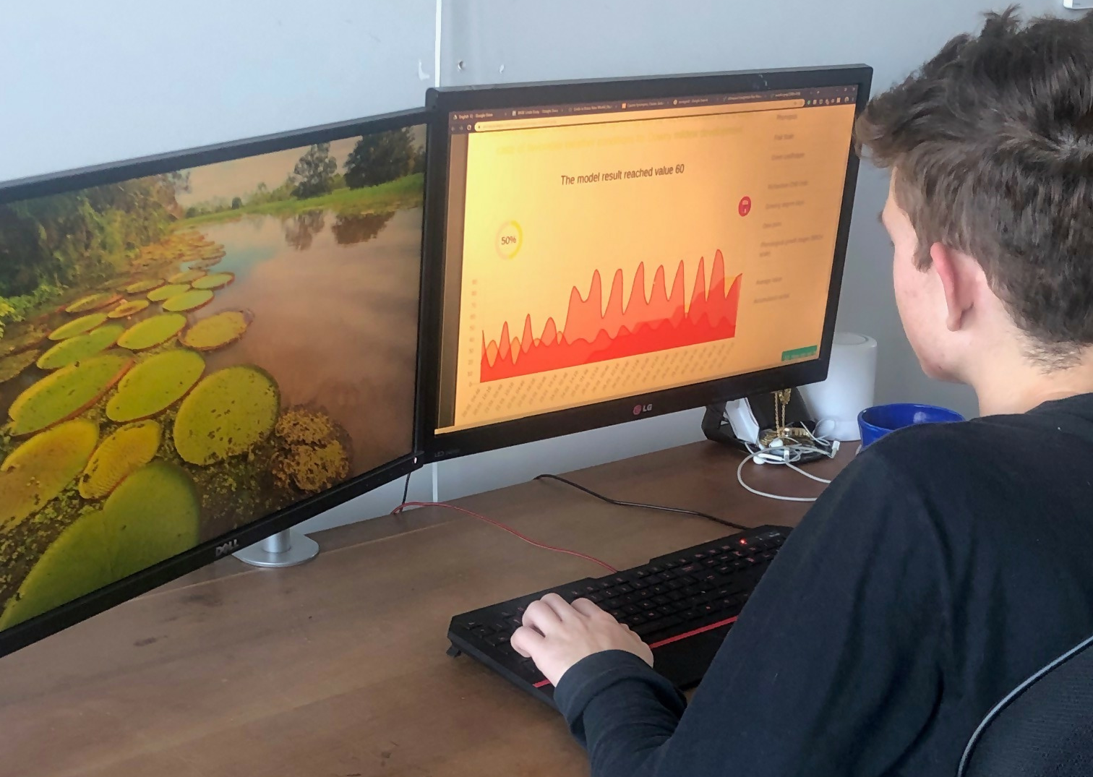
Scroll up
An artificial intelligence system developed by UC Davis, and programmed in the free Python programming language environment, is used to calculate the exact amount of water needed per vine based on local weather-station data and daily evapotranspiration data
One single controller can support up to five irrigation valves. Common practice in vineyard and orchard management is to water only once a week. But our system can water every day and within specific time period to give the plants a better chance to pick up all the moisture and replace.
Our computer system constantly monitor evapotranspiration and soil moisture, and can tell us when to start irrigating, as well as allowing us to remotely control the irrigation valves. The system will automatically turn off the irrigation valves when the optimal soil moisture levels have been reached to save water and produce better fruit quality and yield.
The precise data also allow us to practice regulated deficit irrigation, to “stress” the vines during the setting period, and produce more concentrate fruit without killing the vine.
What Is It?
How It Works
Why We Care
Who To Contact
Scroll Down

Slide 5

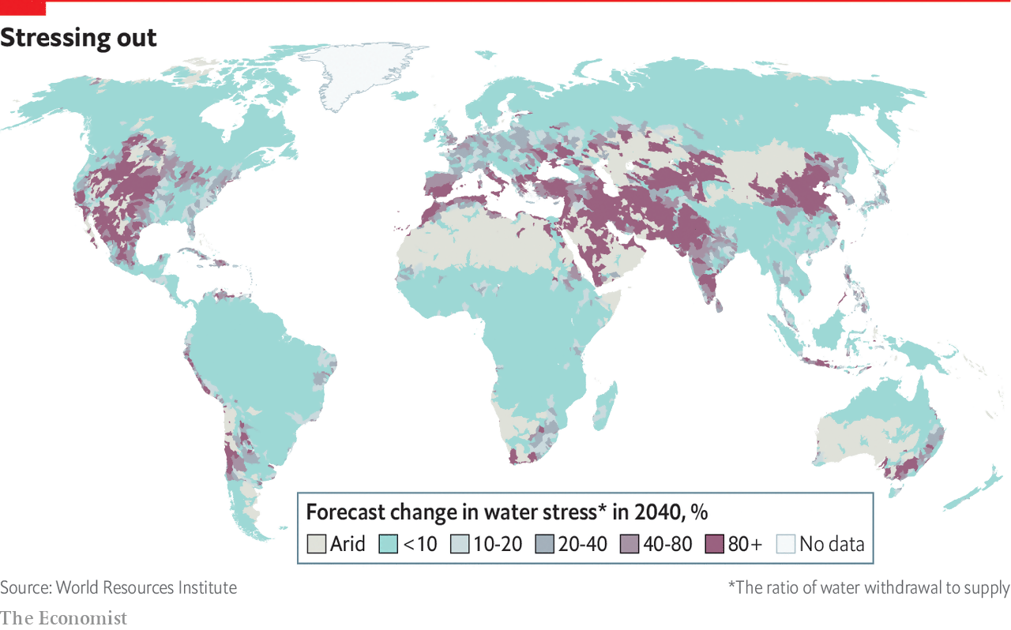
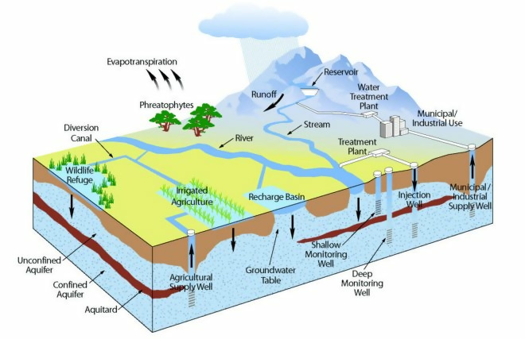
Why We Care
Scroll up
Approximately 70% of the world’s available drinking water is used by agriculture. Therefore, it makes sense to consider technology for optimizing agricultural water use.
According to The Economist, we are in a water crisis. A third of the world’s biggest groundwater systems are in danger of drying out. People living under severe water stress are expected to climb to as many as 3.2 billion by 2050, or 5.7 billion taking seasonal variation into account. And they will not just be in poor countries (see map). United States will also endure severe water shortage in the future.
The best way to solve the world’s water woes is to use less of it. For the world to reduce its use of water, the most obvious area in which to look for savings is where most water goes: agriculture.
In 2014, California passed the Sustainable Groundwater Management Act (SGMA), which sets forth the mission that groundwater resources be managed sustainable for long-term reliability. Regulations will be fully implemented throughout the state by 2022, and there is little doubt that regulations will have a significant impact. Farmers may be required to adhere to a plan designed to recharge the aquifer 1:1 for each gallon of water used in irrigation.
There are still a lot of details we don’t know, but, what we do know is the days of inexpensive water and laissez faire irrigation policies are at an end.
What Is It?
How It Works
Why We Care
Who To Contact
Scroll Down

Slide 6
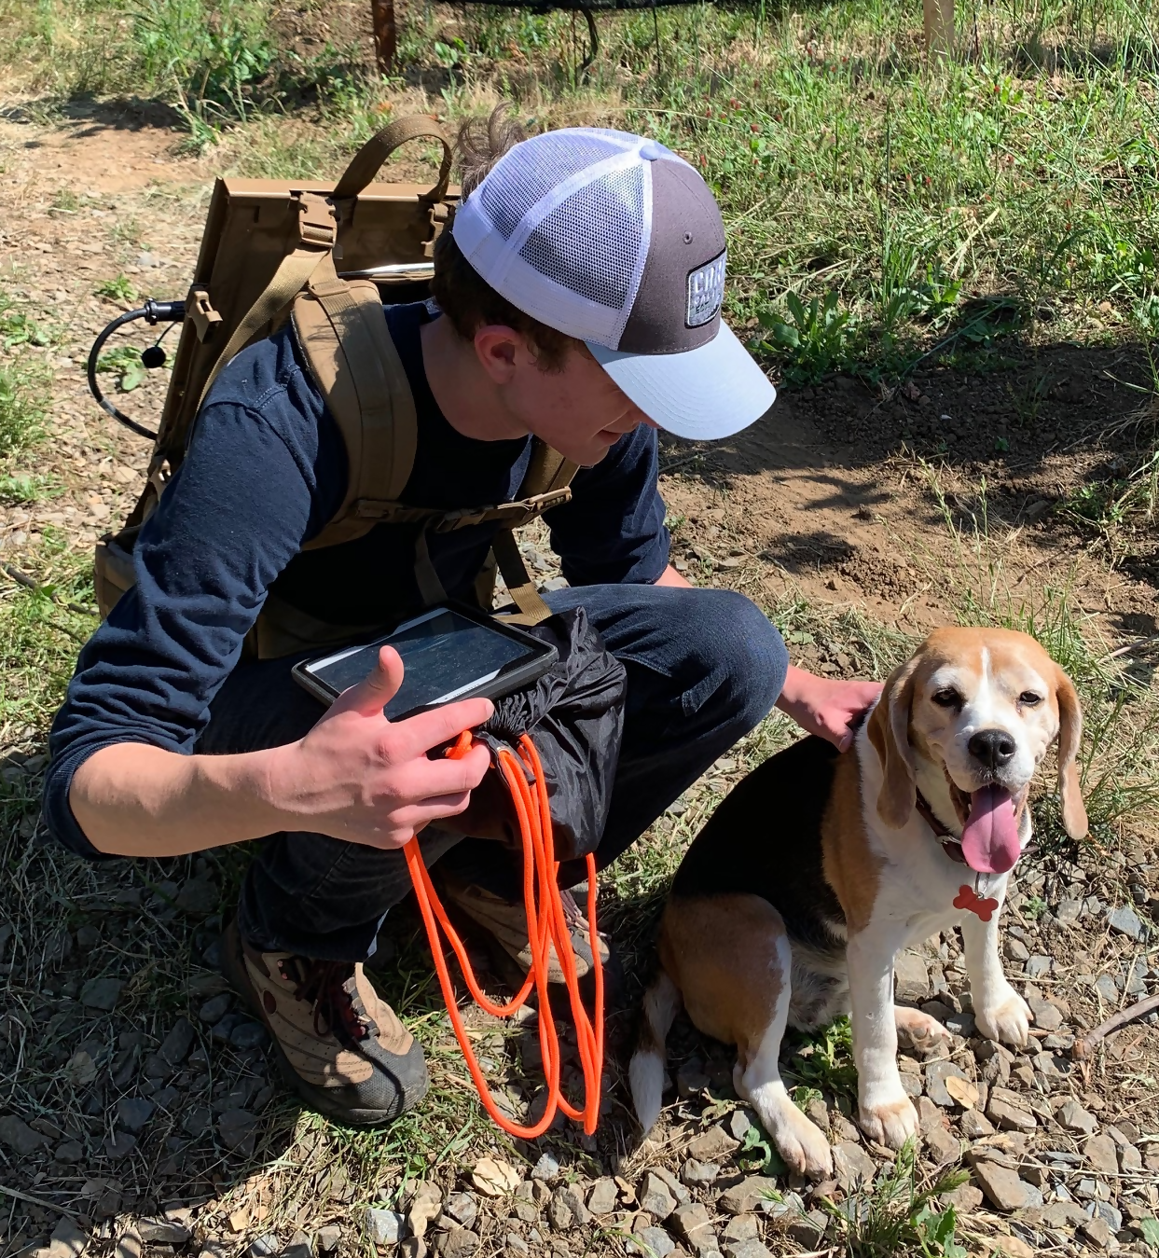
Who to Contact
Scroll up
WATEVER, INC.
For my whole life I’ve wanted to change the world for the better, and after taking classes like Environmental Science, I came to understand how important and vital it is to keep resources, like water, sustainable. I have had the opportunity to experience the beauty of Earth, and so, maintaining it became my main goal. I started Watever, Inc. to try and tackle the problem of overusing and misusing water in the irrigation of plants, specifically in vineyards and orchards, and I hope to expand Watever, Inc. to tackle this problem throughout the world. While it may be a small step in the right direction, I believe it takes many small steps to make such an impact.
Joseph Bruun-Jensen
Founder and CEO
What Is It?
How It Works
Why We Care
Who To Contact
Joseph Bruun-Jensen and his dog, Cookie
We charge a flat fee of $39/month to manage your water
CONTACT US
© Copyright 2019. All rights reserved.
General Conditions.
Cookie Policy

Slide 7
Terms and Conditions ("Terms")
Last updated: August 2019
Please read these Terms and Conditions ("Terms", "Terms and Conditions") carefully before using the http://www.watever.life website (the "Service") operated by Watever, Inc. ("us", "we", or "our").
Your access to and use of the Service is conditioned on your acceptance of and compliance with these Terms. These Terms apply to all visitors, users and others who access or use the Service.
By accessing or using the Service you agree to be bound by these Terms. If you disagree with any part of the terms then you may not access the Service.
Purchases
If you wish to purchase any product or service made available through the Service ("Purchase"), you may be asked to supply certain information relevant to your Purchase including, without limitation, your name, address, phone number, email address and credit card information.
Subscriptions
Some parts of the Service are billed on a subscription basis ("Subscription(s)"). You will be billed in advance on a recurring monthly basis.
Links To Other Web Sites
Our Service may contain links to third-party web sites or services that are not owned or controlled by Watever, Inc.
Watever, Inc. has no control over, and assumes no responsibility for, the content, privacy policies, or practices of any third party web sites or services. You further acknowledge and agree that Watever, Inc. shall not be responsible or liable, directly or indirectly, for any damage or loss caused or alleged to be caused by or in connection with use of or reliance on any such content, goods or services available on or through any such web sites or services.
Changes
We reserve the right, at our sole discretion, to modify or replace these Terms at any time. If a revision is material we will try to provide at least 30 days' notice prior to any new terms taking effect. What constitutes a material change will be determined at our sole discretion.
Contact Us
If you have any questions about these Terms, please contact us.

Slide 8
Cookie Policy
Watever, Inc. (“we” or “us” or “our”) may use cookies, web beacons, tracking pixels, and other tracking technologies when you visit our website watever.life, including any other media form, media channel, mobile website, or mobile application related or connected thereto (collectively, the “Site”) to help customize the Site and improve your experience.
We reserve the right to make changes to this Cookie Policy at any time and for any reason. We will alert you about any changes by updating the “Last Updated” date of this Cookie Policy. Any changes or modifications will be effective immediately upon posting the updated Cookie Policy on the Site, and you waive the right to receive specific notice of each such change or modification.
You are encouraged to periodically review this Cookie Policy to stay informed of updates. You will be deemed to have been made aware of, will be subject to, and will be deemed to have accepted the changes in any revised Cookie Policy by your continued use of the Site after the date such revised Cookie Policy is posted.
USE OF COOKIES
A “cookie” is a string of information which assigns you a unique identifier that we store on your computer. Your browser then provides that unique identifier to use each time you submit a query to the Site. We use cookies on the Site to, among other things, keep track of services you have used, record registration information, record your user preferences, keep you logged into the Site, facilitate purchase procedures, and track the pages you visit. Cookies help us understand how the Site is being used and improve your user experience.
TYPES OF COOKIES
The following types of cookies may be used when you visit the Site:
Advertising Cookies
Advertising cookies are placed on your computer by advertisers and ad servers in order to display advertisements that are most likely to be of interest to you. These cookies allow advertisers and ad servers to gather information about your visits to the Site and other websites, alternate the ads sent to a specific computer, and track how often an ad has been viewed and by whom. These cookies are linked to a computer and do not gather any personal information about you.
Analytics Cookies
Analytics cookies monitor how users reached the Site, and how they interact with and move around once on the Site. These cookies let us know what features on the Site are working the best and what features on the Site can be improved.

Slide 9
Our Cookies
Our cookies are “first-party cookies”, and can be either permanent or temporary. These are necessary cookies, without which the Site won't work properly or be able to provide certain features and functionalities. Some of these may be manually disabled in your browser, but may affect the functionality of the Site.
Personalization Cookies
Personalization cookies are used to recognize repeat visitors to the Site. We use these cookies to record your browsing history, the pages you have visited, and your settings and preferences each time you visit the Site.
Security Cookies
Security cookies help identify and prevent security risks. We use these cookies to authenticate users and protect user data from unauthorized parties.
Site Management Cookies
Site management cookies are used to maintain your identity or session on the Site so that you are not logged off unexpectedly, and any information you enter is retained from page to page. These cookies cannot be turned off individually, but you can disable all cookies in your browser.
Third-Party Cookies
Third-party cookies may be place on your computer when you visit the Site by companies that run certain services we offer. These cookies allow the third parties to gather and track certain information about you. These cookies can be manually disabled in your browser.
CONTROL OF COOKIES
Most browsers are set to accept cookies by default. However, you can remove or reject cookies in your browser’s settings. Please be aware that such action could affect the availability and functionality of the Site.
For more information on how to control cookies, check your browser or device’s settings for how you can control or reject cookies, or visit the following links:
Apple Safari
Google Chrome
Microsoft Edge
Microsoft Internet Explorer
Mozilla Firefox

Slide 10
OTHER TRACKING TECHNOLOGIES
In addition to cookies, we may use web beacons, pixel tags, and other tracking technologies on the Site to help customize the Site and improve your experience. A “web beacon” or “pixel tag” is tiny object or image embedded in a web page or email. They are used to track the number of users who have visited particular pages and viewed emails, and acquire other statistical data. They collect only a limited set of data, such as a cookie number, time and date of page or email view, and a description of the page or email on which they reside. Web beacons and pixel tags cannot be declined. However, you can limit their use by controlling the cookies that interact with them.
PRIVACY POLICY
For more information about how we use information collected by cookies and other tracking technologies, please refer to our Privacy Policy [CLICK HERE]/posted on the Site. This Cookie Policy is part of and is incorporated into our Privacy Policy. By using the Site, you agree to be bound by this Cookie Policy and our Privacy Policy.
CONTACT US
If you have questions or comments about this Cookie Policy, please contact us at [link]

